Slide 1
LECTURE -5
Inferential Statistics
Course Instructor
Engr. Naina Said

Slide 2
CSE-422: Data Analytics
Confidence Intervals
Our ultimate goal is always to find population parameters i.e. population mean and population standard deviation.
Suppose we want to find the average age of the university students.
Person A takes 100 samples from our population (all the students in the university) and record their ages and then find the average mean. Say x̄ =23
This x̄ is just the estimate of the of the actual population mean, not the actual population mean.
Someone else could take another 100 samples and come up with a different sample mean x̄.
Therefore, we need to define a range for the sample means in which we think population mean could lie.

Slide 3
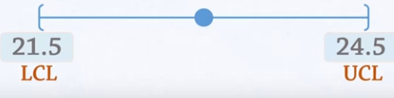
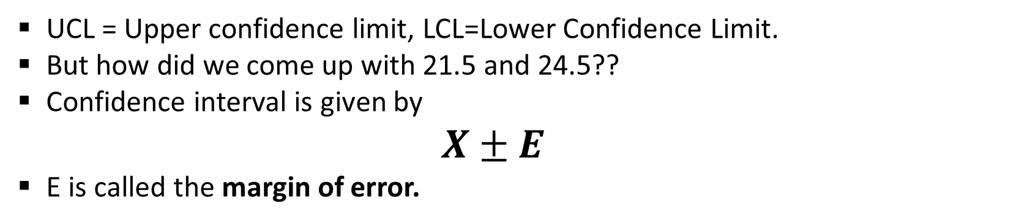
CSE-422: Data Analytics
Confidence Intervals Continued..
For Person A’s experiment, we can say that the range (or confidence interval) is
23
UCL = Upper confidence limit, LCL=Lower Confidence Limit.
But how did we come up with 21.5 and 24.5??
Confidence interval is given by
$$X±E$$
E is called the margin of error.

Slide 4
CSE-422: Data Analytics
Margin of Error
So we need to find E which is the margin of error and add and subtract it to our sample mean to find the interval.
In order to calculate E, we need one of the following
Either the population standard deviation σ
Or the sample standard deviation s.
In most cases, we do not have σ.
But sometimes, we have some historical data which gives us σ
These cases are called sigma known cases.

Slide 5
CSE-422: Data Analytics
Finding Confidence Interval for μ When σ is Known (Single Mean)

Slide 6
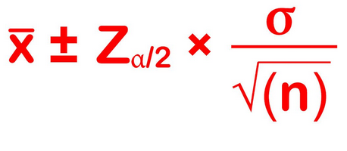
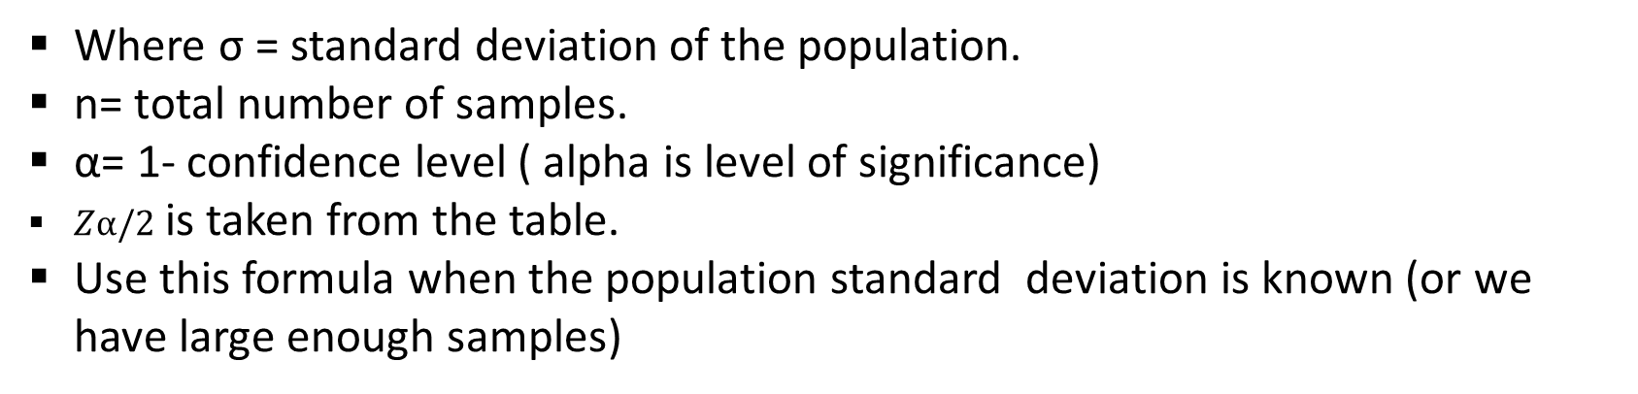
CSE-422: Data Analytics
Calculating Confidence Interval For Sigma known
Confidence Interval =
Where σ = standard deviation of the population.
n= total number of samples.
α= 1- confidence level ( alpha is level of significance)
$Zα/2$ is taken from the table.
Use this formula when the population standard deviation is known (or we have large enough samples)

Slide 7
CSE-422: Data Analytics
Confidence Levels
Margin of Error “E” Is calculated based on confidence level
Confidence level = The percentage of all possible samples that can be expected to include the true population parameter.
Commonly used are 90,95,99 percent.

Slide 8

CSE-422: Data Analytics
Example
Determine the average age of victims of mobile snatching in any city during last year for a sample of size 100 with mean age 34.25 years and population standard deviation 10. Use 95% confidence level.
n = 100
Mean = 34.25 years
For 95% confidence level, z= 1.96 (from the table)
Put these in the formula
Thus Upper limit of CI will be 34.25+1.96=36.21
The lower limit of CI will be 34.25-1.96=32.29
We are 95 percent confident that the average age will be between 36.21 and 32.29

Slide 9
CSE-422: Data Analytics
Things to Remember about Confidence Intervals
Lower confidence levels result in smaller intervals: 90% CI's are smaller than 95% CI's and these are smaller than 99% CI's. The tradeoff here is that smaller intervals are less likely to contain the parameter we're after: 90% versus 95% or 99%
Larger sample sizes result in smaller CI's.
Smaller population SD's result in smaller CI's. However, these are beyond the control of the researcher.

Slide 10
CSE-422: Data Analytics
Finding Confidence Interval for μ When σ is UnKnown (Single Mean)

Slide 11
CSE-422: Data Analytics
Calculating Confidence Interval For Sigma Unknown
We rarely have sigma known.
In such cases, we use s (sample standard deviation) to calculate the confidence intervals.
When we use s, our sampling distribution no more follows a standard normal distribution. (when sample size <30)
So we can not use Z-Statistics ( Z-statistics are for normal distributions)
It follows another type of distribution called “Student’s T Distribution”.
We use T-Statistics for such cases.

Slide 12
CSE-422: Data Analytics
T Distribution
T Distribution is different from the standard normal distribution in the following ways
The variance is greater than 1.
It is based on the concept of “degrees of freedom” which is related to sample size.
As the sample size increases, the T distribution approaches the normal distribution.

Slide 13
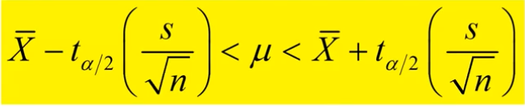
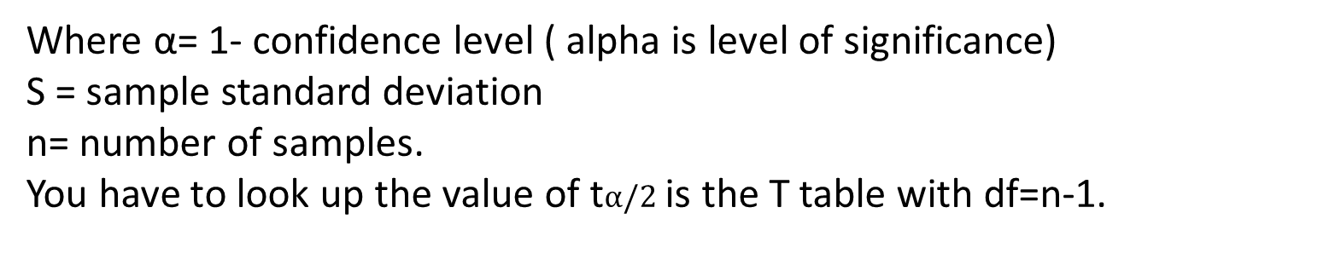
CSE-422: Data Analytics
Calculating Confidence Interval For Sigma Unknown
Where α= 1- confidence level ( alpha is level of significance)
S = sample standard deviation
n= number of samples.
You have to look up the value of t$α/2$ is the T table with df=n-1.

Slide 14
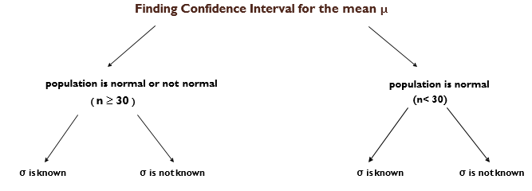
CSE-422: Data Analytics
Deciding the Statistics for Confidence Interval
Use Z Stats
Use Z Stats
Use Z Stats
Use T Stats

Slide 15
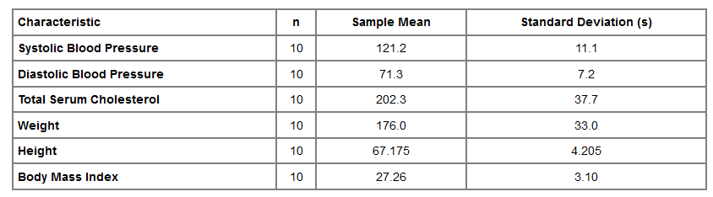
CSE-422: Data Analytics
Example
Consider that some health related data is collected from 10 participants in a study as given below. Compute a 95% confidence interval for the true systolic blood pressure using data in the subsample.

Slide 16

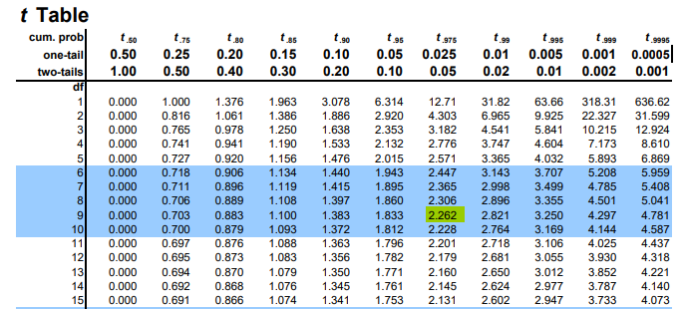
CSE-422: Data Analytics
Solution
Since the sample size is small (<30), we use T-statistics instead of Z statistics in this case.
The sample size is n=10, the degrees of freedom (df) = n-1 = 9.
The t value for 95% confidence with df =
9 is t = 2.262.

Slide 17

CSE-422: Data Analytics
Solution
Substituting the sample statistics and the t value for 95% confidence
we are 95% confident that the true systolic blood pressure in the population is between 113.3 and 129.1. Note that the margin of error is larger here primarily due to the small sample size.

Slide 18
CSE-422: Data Analytics
Finding Confidence Intervals for Difference in Two Means

Slide 19
CSE-422: Data Analytics
Confidence Interval for Difference in two means
There are many situations where it is of interest to compare two groups with respect to their mean scores.
Two groups may be independent or paired/matched.
Examples
we might be interested in comparing mean systolic blood pressure in men and women
Compare body mass index (BMI) in smokers and non-smokers.
Both of these situations involve comparisons between two independent groups (meaning that there are different people in the groups being compared)

Slide 20
CSE-422: Data Analytics
Finding Confidence Intervals for Difference in Two Independent Means

Slide 21


CSE-422: Data Analytics
Confidence Interval Independent Samples
Independent groups mean that there are different people in the groups being compared
Examples
Comparing mean systolic blood pressure in men and women
Compare body mass index (BMI) in smokers and non-smokers.
We could begin by computing the sample sizes (n1 and n2), means ( and ), and standard deviations (s1 and s2) in each sample.
We are interested in estimating the difference in population means, μ₁ - μ₂.
The point estimate for the difference in population means is the difference in sample means
The deviation of the difference is,

Slide 22
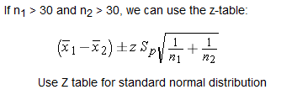

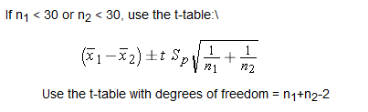
CSE-422: Data Analytics
Confidence Interval for Independent Samples Continued..

Slide 23
CSE-422: Data Analytics
Finding Confidence Intervals for Difference in Two Independent Means (Large Samples)

Slide 24
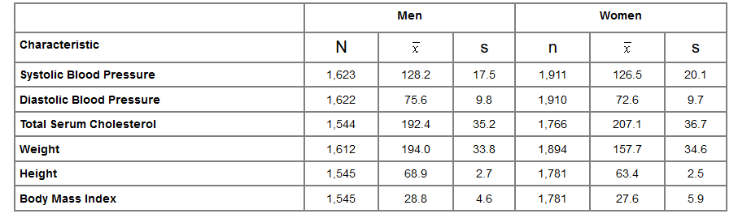
CSE-422: Data Analytics
Example 1
Consider that some health related data is collected from some participants in a study as given below
Calculate the confidence interval for difference in population mean systolic blood pressures between men and women at 95% confidence level?

Slide 25

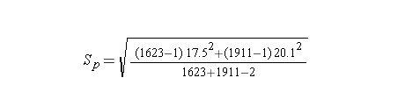
CSE-422: Data Analytics
Solving Example 1
The sample is large (> 30 for both men and women), so we can use the confidence interval formula with Z
First, we need to compute Sp
=19

Slide 26



CSE-422: Data Analytics
Solving Example 1
Next we substitute the Z score for 95% confidence, Sp=19, the sample means, and the sample sizes into the equation for the confidence interval.
Therefore, the confidence interval is (0.44, 2.96)

Slide 27
CSE-422: Data Analytics
Interpretation of Example 1
With 95% confidence the difference in mean systolic blood pressures between men and women is between 0.44 and 2.96 units.
Note that when we generate estimates for a population parameter in a single sample (e.g., the mean [μ]), the resulting confidence interval provides a range of likely values for that parameter
In contrast, when comparing two independent samples in this fashion the confidence interval provides a range of values for the difference.
In this example, we estimate that the difference in mean systolic blood pressures is between 0.44 and 2.96 units with men having the higher values.

Slide 28
CSE-422: Data Analytics
Null Value in Confidence Interval
The confidence intervals for the difference in means provide a range of likely values for (μ1-μ2). It is important to note that all values in the confidence interval are equally likely estimates of the true value of (μ1-μ2). If there is no difference between the population means, then the difference will be zero (i.e., (μ1-μ2).= 0). Zero is the null value of the parameter (in this case the difference in means). If a 95% confidence interval includes the null value, then there is no statistically meaningful or statistically significant difference between the groups. If the confidence interval does not include the null value, then we conclude that there is a statistically significant difference between the groups. For the question on previous slide, there is a statistically significant difference in means between men and women, because the confidence interval does not include the null value 0.

Slide 29
CSE-422: Data Analytics
Finding Confidence Intervals for Difference in Two Independent Means (Small Samples)

Slide 30
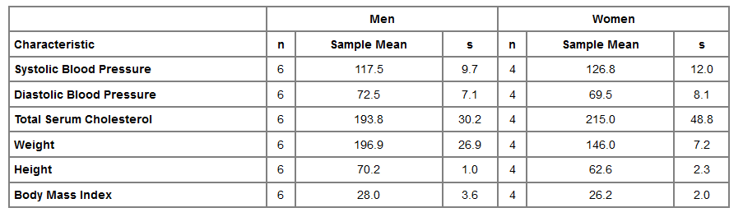
CSE-422: Data Analytics
Example 2
Construct a 95% confidence interval for the difference in mean systolic blood pressures between men and women using these data.

Slide 31

CSE-422: Data Analytics
Solving Example 2
The sample is small (< 30 for both men and women), so we can use the confidence interval formula with T.
First, we need to compute Sp
=10.6

Slide 32


CSE-422: Data Analytics
Solving Example 2
Degrees of freedom (df) = n₁+n₂-2 = 6+4-2 = 8
From the t-Table t=2.306
The 95% confidence interval for the difference in mean systolic blood pressures is
So, the 95% confidence interval for the difference is (-25.07, 6.47)

Slide 33
CSE-422: Data Analytics
Interpretation of Example 2
We are 95% confident that the difference in mean systolic blood pressures between men and women is between -25.07 and 6.47 units
Based on this interval, we also conclude that there is no statistically significant difference in mean systolic blood pressures between men and women, because the 95% confidence interval includes the null value, zero.
Confidence interval is a range of likely values for the difference in means.
Since the interval contains zero (no difference), we do not have sufficient evidence to conclude that there is a difference.

Slide 34
CSE-422: Data Analytics
Finding Confidence Intervals for Difference in Two Paired Means

Slide 35
CSE-422: Data Analytics
Confidence Interval dependent/Paired Samples
In such cases, two comparison groups are dependent.
Data are collected twice from the same participants, called repeated measures
Example
You want to compare the mean weight of same group of people before and after a diet plan.
The goal of these studies might be to compare the mean scores measured before and after the intervention.
Once again we have two samples, and the goal is to compare the two means. However, the samples are related or dependent.

Slide 36
CSE-422: Data Analytics
Unit of Analysis
It is import to appropriately identify the unit of analysis
In the one sample and two independent samples applications participants are the units of analysis.
However, with two dependent samples application, the pair is the unit (and not the number of measurements which is twice the number of units).

Slide 37
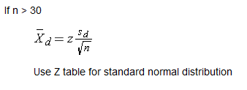

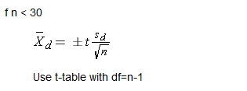
CSE-422: Data Analytics
Confidence Interval dependent/Paired Samples
The parameter of interest is the mean difference, μ_{d}
We compute the sample size (which in this case is the number of distinct participants or distinct pairs), the mean ( ) and standard deviation (s_{d} )of the difference scores.

Slide 38
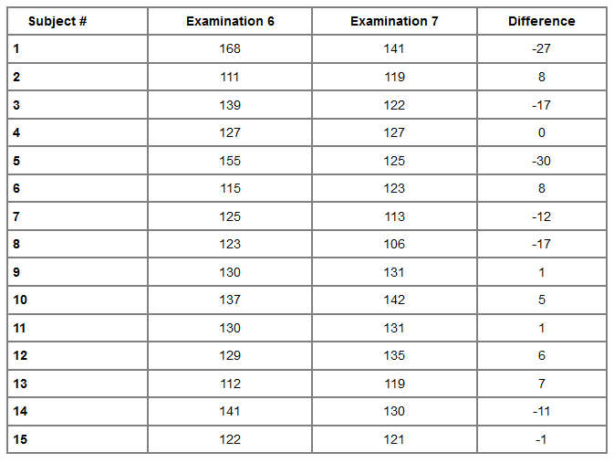
CSE-422: Data Analytics
Example 3
Table below shows 4 years BP data for 15 participants.
Find CI for mean difference over 4 years with 95% confidence level

Slide 39
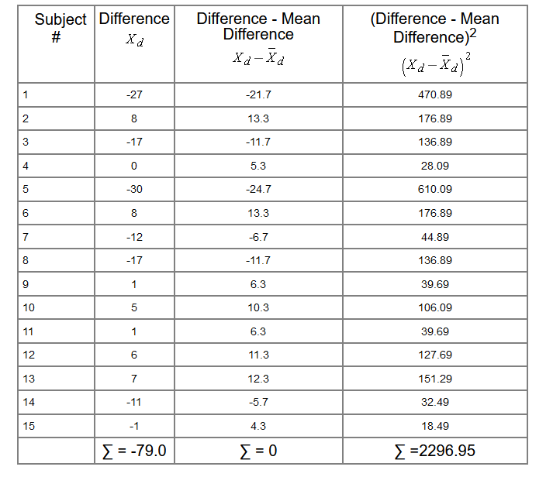
CSE-422: Data Analytics
Example 3

Slide 40



CSE-422: Data Analytics
Example 3
T value for df= 14 and 95% confidence level = 2.145
Substitute all these values in the formula
So, the 95% confidence interval for the difference is (-12.4, 1.8)

Slide 41
CSE-422: Data Analytics
Interpretation of Example 3
We are 95% confident that the mean difference in systolic blood pressures between examinations 6 and 7 (approximately 4 years apart) is between -12.4 and 1.8.
Based on the 95% confidence interval we can conclude that there is no statistically significant difference in blood pressures over time, because the confidence interval for the mean difference includes zero

